Slide 1
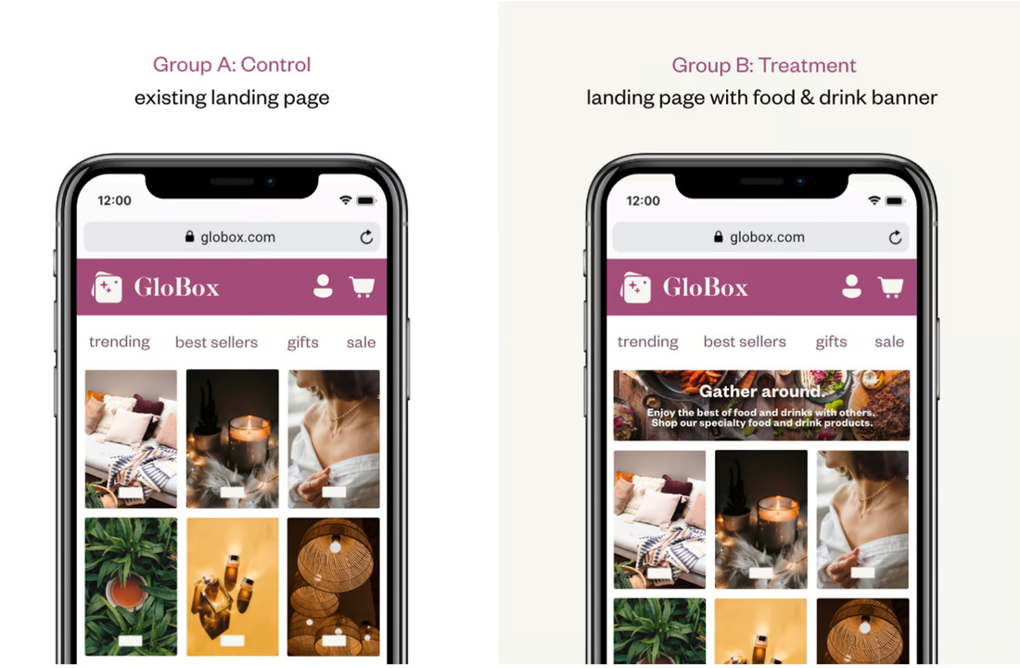
Globox A/B Test analysis
Azat Beisheev

Slide 2
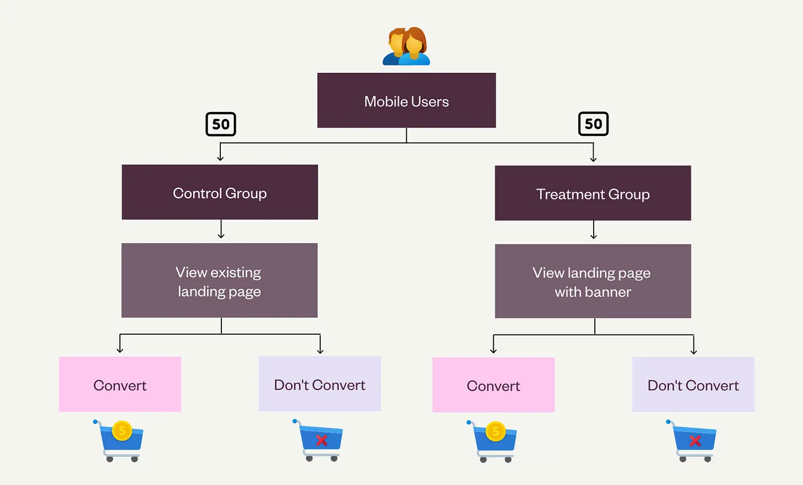
Introduction
Task: will the new banner increase revenue?
Two equal group of users randomly assigned to “control = A” and “treatment = B”.
Total: 48,943 users
The base metrics: “Conversion rate” and “Average amount per user”.
The test run between January 25 and February 6.

Slide 3
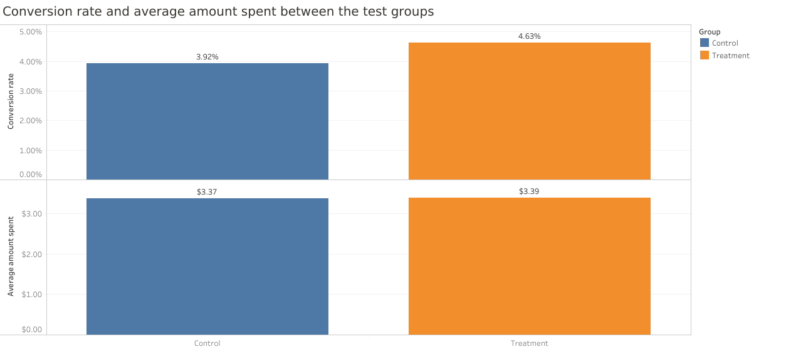
Treatment group vs Control group
Conversion rate of treatment group is higher than control group
No significant difference in average amount spent

Slide 4
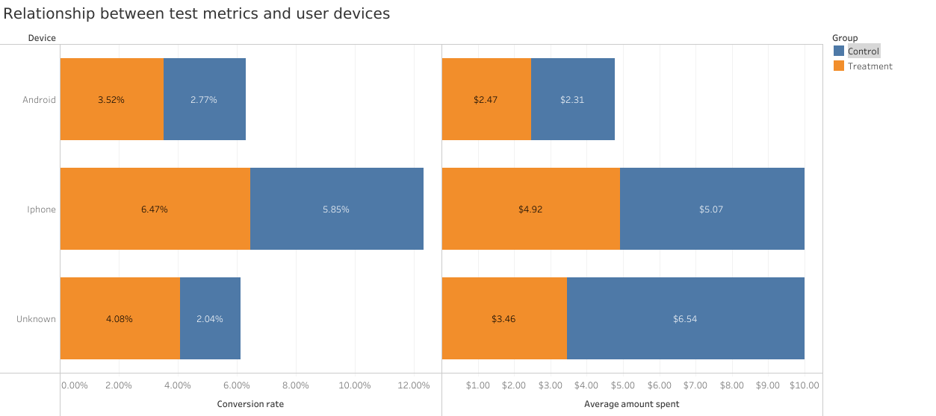
The relationship between test metrics and user’s device.
The highest conversion rate 6.47% for a treatment group has IOS users and it is slightly higher than control group 5.85%.
The highest average amount spent 4.92$ for a treatment group also has IOS users but here it’s lower than control group 5.07$.

Slide 5
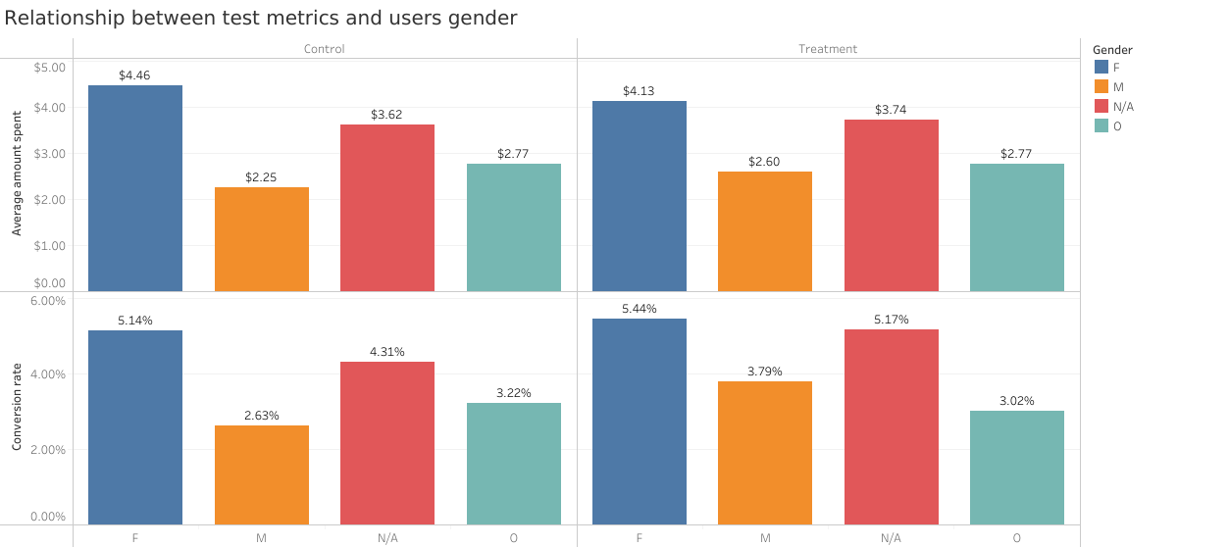
The relationship between metrics and users gender
Females have highest conversion rate 5.44% for a treatment group among other genders.
The highest average amount spent 4.13$ for a treatment group also has females however here it is lower than Control group 4.46$.

Slide 6
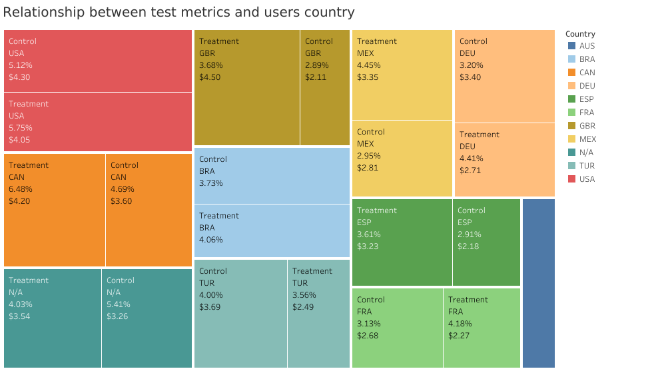
Relationship between test metrics and users country
Canada has highest conversion rate for a treatment group 6.48% higher than control group 4.69%.
Great Britain has highest average amount spent 4.50$ and it is higher than control group 2.11$.

Slide 7
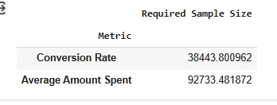
Power analysis
Do we have enough # of users for analysis?
Current sample size for each group
Conversion rate 24,600
Average amount 24,600
VS
Result: Need more # of users for more precise analysis

Slide 8
Novelty test
Did banner impact to conversion raise?
Result: New banner didn’t impact to conversion raise

Slide 9

Recommendation:
High conversion is not always high revenue.
Required sample size is much higher than sample size we used in our test.
New banner has no impact on conversions raise.
Conclusion: New banner will not increase revenue.
Do not launch

